Slide 1

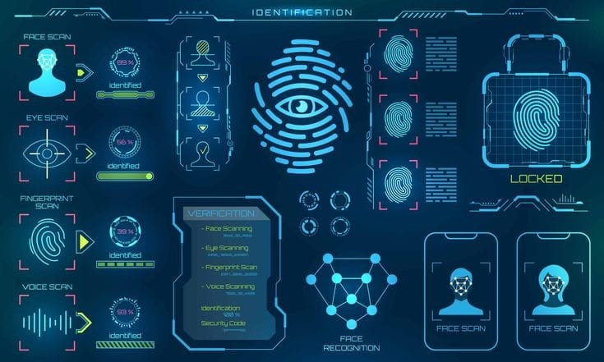
Authentication USING BIOMETRIC TECHNOLOGY jun-2021
Presented By,
Deepika H.R

Slide 2
What Is A Biometric?
Biometric Are Automated Methods Of Identifying A Person Or Verifying The Identity Of A Person Based On A Physiological Or Behavioural Characteristic.
Most Definitive, Real-time Tool Available Today.
Recognizes Individuals Definitively.
What Is Authentication?
It Is The Process Of Giving Someone Identity So That He Or She Can Access That Particular Application Or Data.
Authentication Is A Act Of Confirming Something What It Claims To Be.

Slide 3
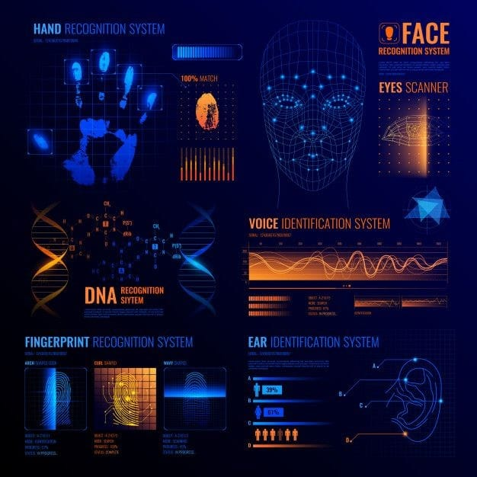
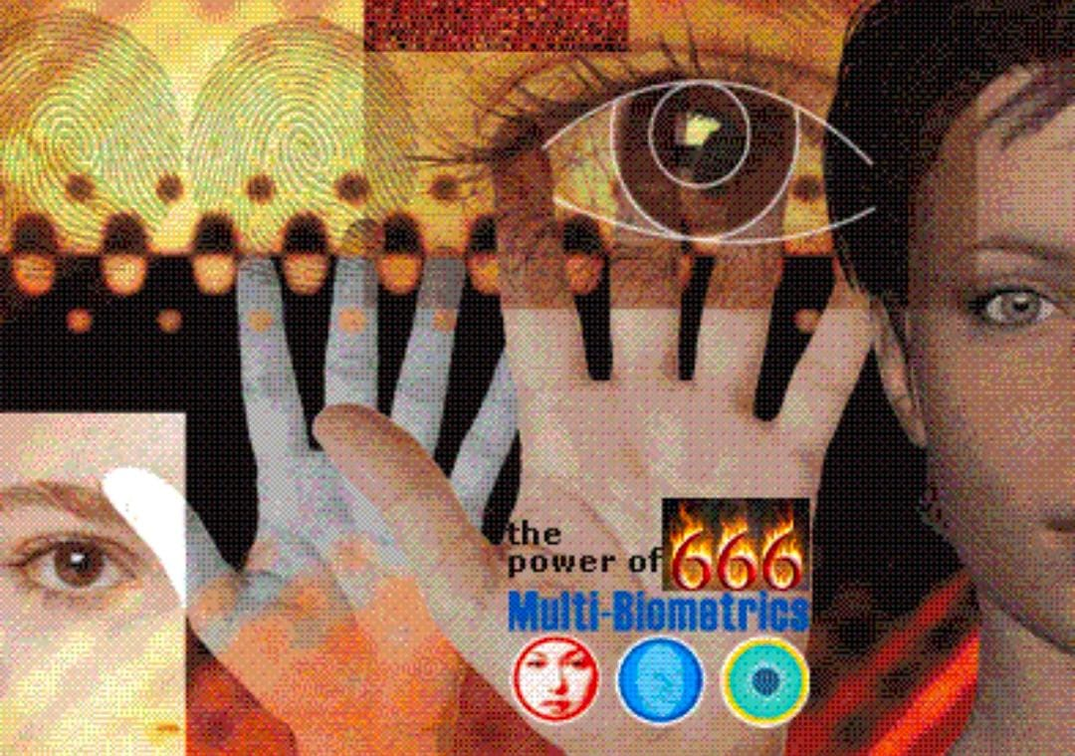
Behavioural Characteristics Are:
Keystroke Dynamics
Voice
Gait
Signature Dynamics
Physical Characteristics Are:
Face
Retina
Iris
Hand geometry
Fingerprint

Slide 4
Advantages Of Biometrics:
High Security And Assurance
User Experience
Non-transferrable
Disadvantages Of Biometrics:
Coast
Data Breaches
False Positive And Inaccuracy

Slide 5
Application Of Biometrics:
Government- Passports ,national Identification Cards ,voter Cards , driver’s Licenses , social Services And Any More.
Transportation-airport Security ,boarding Passes, and Commercial Driver’s Licenses.
Healthcare-medical Insurance Card, patient/Employee Identity Cards.
Financial-bankcards, ATM Cards, credit Cards, And Debit Cards.
Security-access Control And Identity Verifications, Including Time And Attendance.
Education-student/Teacher Identity Verification And Access Control.

Slide 6
Conclusion :
Biometric Authentication Has Strongly Expanded In The Last Few Years, With More And More Consumers Relaying On It And Even Demanding For It .The Biometric Authentication Has Several Advantages. First The Biometric Authenticates Only People .It Can Not Authenticate Computer As The Classical Authentication Methods Which Are Based On Ip Address Or Public Key. The Biometric Characteristics That Are Used In Authentication System Are Unique For Each Person.

